Slide 1
Building a Biosimilar Medicine
Edward Li, PharmD, BCOP
University of New England College of Pharmacy
Portland, Maine

Slide 2

Learning Objectives
Explain the developmental and regulatory pathway for biosimilars and discuss how this differs from other medicines
Assess the regulatory, legislative, and economic considerations associated with the use of biosimilars in the United States, including the impact on cost and appropriate naming conventions
Evaluate current clinical trial evidence regarding the efficacy and safety of biosimilars for the treatment of breast cancer and lymphoma

Slide 3
Biosimilar Definitions by Regulatory Agencies
US Food and Drug Administration (FDA)
A biological product that is highly similar to a US-licensed reference biological product notwithstanding minor differences in inactive components, and for which there are no clinically meaningful differences in safety, purity, or potency of the product
European Medicines Agency (EMA)
…structurally highly similar versions of an already authorized biological medicinal product (the reference product) with demonstrated similarity in physicochemical characteristics, efficacy, and safety, based on a comprehensive comparability exercise
FDA Draft Guidance. Rockville, MD: Center for Drug Evaluation and Research, Center for Biologics Evaluation and Research; U.S. Department of Health and Human Services, Food and Drug Administration; 2012. Available at: www.fda.gov/downloads/Drugs/GuidanceComplianceRegulatoryInformation/Guidances/UCM291128.pdf
Weise M, et al. Nat Biotechnol. 2011;29(8):690-693. Accessed November 3, 2014.

Slide 4
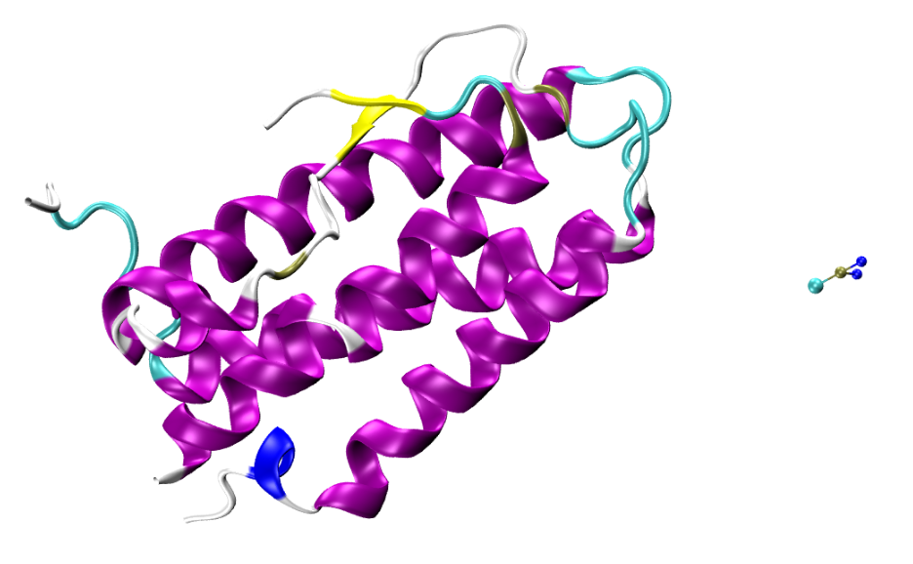
Biologics vs Small Molecule Drugs
Human EPO
165 amino acids
MW ~ 34,000 Da
Biologics are far more complex than traditional small molecule drugs in:
Molecular weight
Structure (tertiary and quaternary structures, post-translational modifications)
Manufacturing/production process
Immunogenicity
Cisplatin
(NH₃)₂PtCl₂
MW ~ 300 Da
Courtesy of: Olgun Guvench, MD, PhD, University of New England College of Pharmacy

Slide 5
Biologics Have a Complex Manufacturing Process
The final biologic product is highly dependent on the manufacturing process:
Clone DNA into vector
Transfer DNA into host cell for expression
Cell expansion
Cell production in bioreactors
Recovery of biologic
Filtration
Centrifugation
Purification through chromatography
Characterization and stability
Mellstedt H, et al. Ann Oncol. 2008;19(3):411-419.

Slide 6
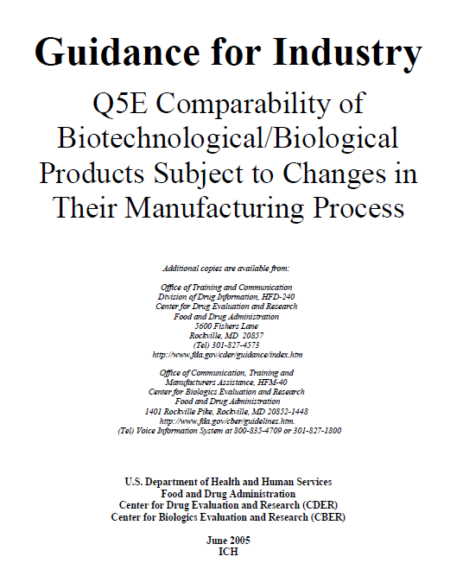
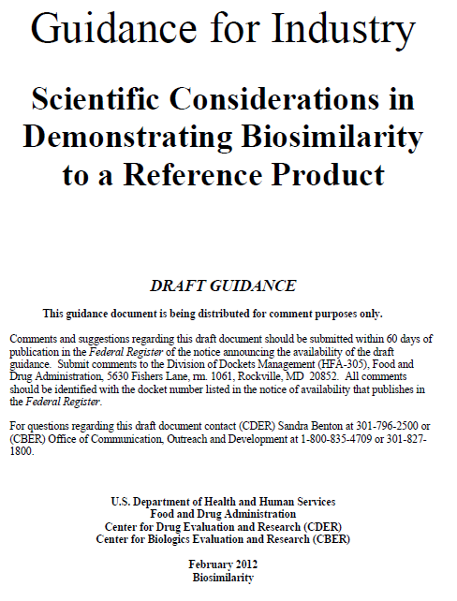
Biologic Manufacturing Changes
INTRA-Manufacturer
INTER-Manufacturer
Feb 2012
June 2005
Guidance for Industry: Q5E: Comparability of Biotechnological/Biological Products Subject to Changes in Their Manufacturing Process. US Food and Drug Administration. 2005. Available at: www.fda.gov/downloads/RegulatoryInformation/Guidances/ucm128076.pdf. Accessed November 22, 2011. FDA Draft Guidance. Rockville, MD: Center for Drug Evaluation and Research, Center for Biologics Evaluation and Research; U.S. Department of Health and Human Services, Food and Drug Administration; 2012. Available at: www.fda.gov/downloads/Drugs/GuidanceComplianceRegulatoryInformation/Guidances/UCM291128.pdf. Accessed November 5, 2014.

Slide 7
Pathway for Biosimilars in the US
Two federal laws for the approval of pharmaceuticals in the United States
Food, Drug, and Cosmetic Act (FDCA)
New drug application (NDA)
Drug Price Competition and Patent Term Restoration Act of 1984 (informally known as Hatch-Waxman Act) created generic pathway
Public Health Service Act (PHSA)
Biologics License Application (BLA)
Patient Protection and Affordable Care Act of 2010, as amended by the Health Care and Education Reconciliation Act of 2010 (the Healthcare Reform Law)
Subtitle called the Biologics Price Competition and Innovation Act of 2009
Amends the Public Health Service Act to define an abbreviated application process for biosimilars
Zelenetz AD, et al. J Natl Compr Canc Netw. 2011; 9(Suppl 4):S1-S22.
Notes:
HATCH WAXMAN info:
A genuine compromise: patent term restoration for innovators coupled with rapid approval of generic products on patent expiry
Main approval procedure (ANDA) designed for small-molecule, chemically-synthesized drugs
Active ingredients must be “the same”
No clinical trials except for bioequivalence studies in healthy subjects, based on pre-existing FDA regulations and long-established scientific principles
No requirement for therapeutic equivalence evaluations, but FDA had well-established process already in place for making them -- there was a backlog of activity that Hatch-Waxman unleashed
FDA guidance delayed on multiple occasions
After 3 years and litigation, a growth hormone product was approved by FDA in 2006
But FDA was explicit that product was:
not a generic biologic,
not equivalent to innovator,
not a pathway for future approvals
Became clear legislation was required to clarify approval process
Public Health Service Act
NOT Food, Drug, and Cosmetic Act
(OLD)
A clear regulatory framework for approval of biologic generics does not yet exist. In a casesome considered a test of FDA policy, the agency denied Sandoz’ application for their Omnitrope, a copy of Pfizer’s somatropin product, Genotropin.86,87 The case clearly indicates that current regulations are not adequate to address approval of biologic generics. Guidance from the FDA on the regulatory issues regarding biologic generics was highly anticipated in summer 2004, but it has been delayed.88 According to one FDA official, the planned guidance was not
innovative, but will represent an important step forward.89 The FDA has sought to make the
guidance development process more public, and an open meeting is planned for early 2005.90,91
Ultimately, legislative action may be necessary to fully clarify the approval process for biologic
generics.
ALL ALONG – could do full development program
- announcement of a White Paper “in the next months”, draft guidance
documents and a third public forum
- nothing happened
• The US Omnitrope-story:
- 07/2003: 505(b)(2) Omnitrope application
- 2004: FDA declined that a decision could be made due to “unresolved
scientific and legal issues”
- 09/2005: Sandoz files a lawsuit against the FDA for failure to take action
on its pending application
- 04/2006: Court ordered the FDA to comply with its statutory obligation to
act on the application
- 06/2006: FDA approval

Slide 8
Pathways for Approval in the USA
Drugs
Small-molecules
Approved via FDCA
Biologics
Proteins
Approved via PHSA
New Drug Application
(NDA)
Abbreviated New Drug Application
(ANDA)
Biologics License Application (BLA)
351(a)
Biosimilar Biologics License Application
351(k)
Safety and Efficacy must be demonstrated
Bioequivalence must be demonstrated
Safety and Efficacy must be demonstrated
Must demonstrate that it is highly similar to reference
Extensive comparability exercise addresses drift
(Q5E)
Interchangeable biosimilars require more data

Slide 9
Demonstrating Biosimilarity: General Principles
The clinical efficacy and safety of the biologic molecule has already been demonstrated (ie, by the innovator)
The biosimilar sponsor only requires evidence that the candidate biosimilar is not significantly different from the reference product
Goal is not to replicate unnecessary clinical trials
Smaller-scale direct comparisons and extrapolation
When a biosimilar is approved, there should not be an expectation that there will be differences in safety and efficacy
FDA Draft Guidance. Rockville, MD: Center for Drug Evaluation and Research, Center for Biologics Evaluation and Research; U.S. Department of Health and Human Services, Food and Drug Administration; 2012. Available at: www.fda.gov/downloads/Drugs/GuidanceComplianceRegulatoryInformation/Guidances/UCM291128.pdf. Accessed November 5, 2014.

Slide 10
Demonstrating Biosimilarity: A Stepwise Approach
Compare proposed biosimilar to reference in terms of:
Structure
Function
Animal Toxicity Studies
Human Pharmacokinetics (PK) and Pharmacodynamics (PD)
Clinical Immunogenicity
Clinical Safety and Effectiveness
FDA intends to utilize a “totality of the evidence” approach
FDA Draft Guidance. Rockville, MD: Center for Drug Evaluation and Research, Center for Biologics Evaluation and Research; U.S. Department of Health and Human Services, Food and Drug Administration; 2012. Available at: www.fda.gov/downloads/Drugs/GuidanceComplianceRegulatoryInformation/Guidances/UCM291128.pdf. Accessed November 5, 2014.
Notes:
At each step, the sponsor should evaluate the extent to which there is residual uncertainty about the biosimilarity of the proposed product and identify next steps to try to address that uncertainty
Structure and Function
Serve as the “foundation” of biosimilar development
Useful in determining what future studies are necessary
Structure
Amino acid sequence, higher-order structures, glycosylation, pegylation, etc.
Analyze lot-to-lot variability
Function
Evaluate pharmacologic activity via in vitro or in vivo experiments
Functional evaluation that compares candidate to reference

Slide 11
Biosimilar Development Approach
Postmarketing Monitoring
Test and confirm biosimilarity
Develop highly similar biologic
EU Guidance and risk management plans
FDA consultation of proposed approach
May be mandatory
Analytical methods for structure/function
Cell lines
In vitro/vivo models
Substance pilot and final scale
Formulation and final drug product
Human clinical trials
Consideration of clinically sensitive endpoints
Clinically sensitive patient population
Immunogenicity
Efficacy and safety
Test and confirm Interchangeability
No explicit FDA guidance
Will be “difficult” to do in the initial 351(k) application
FDA Approval
Adapted from: McCamish M, et al. Clin Pharmacol Ther. 2012;91(3):405-417.
FDA Draft Guidance for Industry. Rockville, MD: Center for Drug Evaluation and Research, Center for Biologics Evaluation and Research; U.S. Department of Health and Human Services, Food and Drug Administration; 2012. Available at: www.fda.gov/downloads/Drugs/GuidanceComplianceRegulatoryInformation/Guidances/UCM273001.pdf. Accessed November 5, 2014.

Slide 12
Structure and Function
Serve as the “foundation” of biosimilar development
Useful in determining what future studies are necessary
Structure
Amino acid sequence, higher-order structures, glycosylation, pegylation, etc
Analyze lot-to-lot variability
Function
Evaluate pharmacologic activity via in vitro or in vivo experiments
Functional evaluation that compares candidate to reference
FDA Draft Guidance. Rockville, MD: Center for Drug Evaluation and Research, Center for Biologics Evaluation and Research; U.S. Department of Health and Human Services, Food and Drug Administration; 2012. Available at: www.fda.gov/downloads/Drugs/GuidanceComplianceRegulatoryInformation/Guidances/UCM291128.pdf. Accessed November 5, 2014.

Slide 13
Four Assessments of Analytical Characterization
Studies of Structure & Function: Residual
Uncertainty
High
Not similar
No further development through 351(k)
Additional information needed: analytical, comparative PK/PD, etc.
Similar
Highly similar
High confidence; appropriate for targeted clinical studies
Highly similar with fingerprint-like similarity
Very high confidence; appropriate for more targeted clinical studies
Low
FDA Draft Guidance. Rockville, MD: Center for Drug Evaluation and Research, Center for Biologics Evaluation and Research; U.S. Department of Health and Human Services, Food and Drug Administration; 2012. Available at: www.fda.gov/downloads/Drugs/GuidanceComplianceRegulatoryInformation/Guidances/UCM397017.pdf. Accessed July 30, 2014.

Slide 14
Biosimilar Development Approach
Postmarketing Monitoring
Test and confirm biosimilarity
Develop highly similar biologic
EU Guidance and risk management plans
FDA consultation of proposed approach
May be mandatory
Analytical methods for structure/function
Cell lines
In vitro/vivo models
Substance pilot and final scale
Formulation and final drug product
Human clinical trials
Consideration of clinically sensitive endpoints
Clinically sensitive patient population
Immunogenicity
Efficacy and safety
Test and confirm Interchangeability
No explicit FDA guidance
Will be “difficult” to do in the initial 351(k) application
FDA Approval
Adapted from: McCamish M, et al. Clin Pharmacol Ther. 2012;91(3):405-417.
FDA Draft Guidance for Industry. Rockville, MD: Center for Drug Evaluation and Research, Center for Biologics Evaluation and Research; U.S. Department of Health and Human Services, Food and Drug Administration; 2012. Available at: www.fda.gov/downloads/Drugs/GuidanceComplianceRegulatoryInformation/Guidances/UCM273001.pdf. Accessed November 5, 2014.

Slide 15
Human Pharmacokinetics & Pharmacodynamics: FDA
“Fundamental” for demonstrating biosimilarity
Both PK and PD will be necessary
PK: Patient population considerations
PD should study measures that are:
Relevant to clinical outcomes
Can be quickly assessed with precision
Has the sensitivity to detect clinically meaningful difference
Ideally correlate exposure to clinical outcomes
FDA Draft Guidance. Rockville, MD: Center for Drug Evaluation and Research, Center for Biologics Evaluation and Research; U.S. Department of Health and Human Services, Food and Drug Administration; 2012. Available at: www.fda.gov/downloads/Drugs/GuidanceComplianceRegulatoryInformation/Guidances/UCM291128.pdf. Accessed November 5, 2014.

Slide 16
EMA Guidance: G-CSF
Pharmacokinetics:
Single dose crossover design using SC and IV administration
Primary endpoint: AUC
Secondary endpoints: Cmax and half-life
General principles for demonstration of bioequivalence are applicable
Pharmacodynamics:
ANC relevant PD marker for G-CSF
Compare biosimilar to reference in healthy volunteers
CD34 count secondary endpoint
Annex to Guideline on Similar Biological Medicinal Products Containing Biotechnology-Derived Proteins as Active Substance: Non-Clinical and Clinical Issues. London: Committee for Medicinal Products for Human Use; European Medicines Agency; 2006. Available at: www.ema.europa.eu/docs/en_GB/document_library/Scientific_guideline/2009/09/WC500003955.pdf. Accessed November 5, 2014.

Slide 17
Clinical Studies: FDA
Clinical Immunogenicity
Goal is to evaluate potential differences in incidence and severity of immune responses using endpoints such as antibody formation (binding, neutralizing), cytokine levels, etc
FDA recommends a comparative parallel study
Efficacy & Safety: Specific clinical trial design will depend on what residual questions remain
Clinical studies should be designed to demonstrate neither decreased nor increased activity
Use clinically relevant and sensitive endpoints in the right population
Schellekens H. NDT Plus. 2009;2(Suppl 1):i27-i36.
Notes:
Clinical immunogenicity endpoints include: antibody formation (binding, neutralizing), cytokine levels, etc.
Ultimately, only clinical studies and post-authorization pharmacovigilance to monitor potential immunogenicity will provide definitive evidence for product comparability to the innovator product with respect to safety and efficacy”

Slide 18
EMA Guidance: G-CSF
Clinical efficacy studies
Many indications recognized
“Recommended” model is prophylaxis of severe neutropenia following cytotoxic chemotherapy known to cause severe neutropenia in a homogenous patient group, emphasis on 1st chemo cycle
Two-arm comparability design if one chemotherapy regimen used and frequency/duration of neutropenia is well known
Three arms (with placebo) may be needed if other chemo regimens used
Sponsor to justify comparability delta
Allows extrapolation to other indications of the reference product if the MOA is the same
Annex to Guideline on Similar Biological Medicinal Products Containing Biotechnology-Derived Proteins as Active Substance: Non-Clinical and Clinical Issues. London: Committee for Medicinal Products for Human Use; European Medicines Agency; 2006. Available at: www.ema.europa.eu/docs/en_GB/document_library/Scientific_guideline/2009/09/WC500003955.pdf. Accessed November 5, 2014.

Slide 19
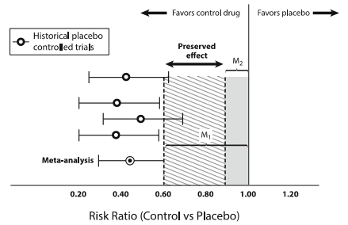
Clinical Trial Design: Equivalence
Establishing the equivalence margin (comparability delta - δ) via the 95-95 method
Dranitsaris G, et al. Invest New Drugs. 2013;31(2):479-487.

Slide 20
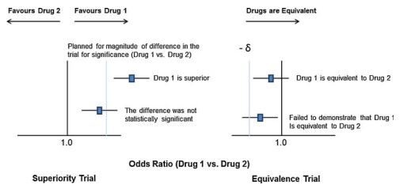
Clinical Trial Design: Equivalence
Null hypothesis: The biosimilar and the reference product are not equivalent (biosimilar is better or worse)
Alternative hypothesis: Biosimilar and reference are equivalent
+δ
Dranitsaris G, et al. Invest New Drugs. 2013;31(2):479-487.
Notes:
The determination of sample size in an equivalence trial is similar to that of a superiority design with one major difference. The former design must incorporate an equivalence margin, often termed δ, into the sample size calculation. This term δ is also called the “minimally clinically important difference” and has been defined as the difference that physicians or patients are willing to accept between two competing therapies before they deem them to be clinically different

Slide 21
EMA Guidance: G-CSF
Clinical safety
Collect data from repeat dosing preferably in a comparative clinical trial
Total exposure should correspond to routine clinical practice
Total follow-up for at least 6 months
Adequate numbers to asses bone pain and laboratory abnormalities
Immunogenicity data to be collected
Annex to Guideline on Similar Biological Medicinal Products Containing Biotechnology-Derived Proteins as Active Substance: Non-Clinical and Clinical Issues. London: Committee for Medicinal Products for Human Use; European Medicines Agency; 2006. Available at: www.ema.europa.eu/docs/en_GB/document_library/Scientific_guideline/2009/09/WC500003955.pdf. Accessed November 5, 2014.

Slide 22
Biosimilar Development Approach
Postmarketing Monitoring
Test and confirm biosimilarity
Develop highly similar biologic
EU Guidance and risk management plans
FDA consultation of proposed approach
May be mandatory
Analytical methods for structure/function
Cell lines
In vitro/vivo models
Substance pilot and final scale
Formulation and final drug product
Human clinical trials
Consideration of clinically sensitive endpoints
Clinically sensitive patient population
Immunogenicity
Efficacy and safety
Test and confirm Interchangeability
No explicit FDA guidance
Will be “difficult” to do in the initial 351(k) application
FDA Approval
Adapted from: McCamish M, et al. Clin Pharmacol Ther. 2012;91(3):405-417.
FDA Draft Guidance for Industry. Rockville, MD: Center for Drug Evaluation and Research, Center for Biologics Evaluation and Research; U.S. Department of Health and Human Services, Food and Drug Administration; 2012. Available at: www.fda.gov/downloads/Drugs/GuidanceComplianceRegulatoryInformation/Guidances/UCM273001.pdf. Accessed November 5, 2014.

Slide 23
Interchangeability
Safety standards for determining interchangeability
Must be a biosimilar
Produces same clinical result as the reference in any given patient
Risk of safety or diminished efficacy due to alternating or switching between biosimilar and reference is no more than using the reference product with no switching
Will be “difficult” in the initial 351(K) application due to the sequential nature of the assessment
Appropriate to be “substituted for the reference product without the intervention of the health care provider who pre­scribed the reference product”
The study design to demonstrate interchangeability has not been fully determined
Chow SC, et al. Stat Med. 2013;32(3):442-428.
PHS Act, section 351(k)(4). Available at: www.fda.gov/downloads/drugs/guidancecomplianceregulatoryinformation/ucm216146.pdf. Accessed November 5, 2014.

Slide 24
Biosimilar Development Approach
Postmarketing Monitoring
Test and confirm biosimilarity
Develop highly similar biologic
EU Guidance and risk management plans
FDA consultation of proposed approach
May be mandatory
Analytical methods for structure/function
Cell lines
In vitro/vivo models
Substance pilot and final scale
Formulation and final drug product
Human clinical trials
Consideration of clinically sensitive endpoints
Clinically sensitive patient population
Immunogenicity
Efficacy and safety
Test and confirm Interchangeability
No explicit FDA guidance
Will be “difficult” to do in the initial 351(k) application
FDA Approval
Adapted from: McCamish M, et al. Clin Pharmacol Ther. 2012;91(3):405-417.
FDA Draft Guidance for Industry. Rockville, MD: Center for Drug Evaluation and Research, Center for Biologics Evaluation and Research; U.S. Department of Health and Human Services, Food and Drug Administration; 2012. Available at: www.fda.gov/downloads/Drugs/GuidanceComplianceRegulatoryInformation/Guidances/UCM273001.pdf. Accessed November 5, 2014.

Slide 25
Post-Market Monitoring: EU Risk Management Plans
“Comprehensive and proactive application of scientifically based methodologies to identify, assess, communicate, and mitigate risk throughout a drug’s life cycle so as to establish and maintain a favorable benefit-risk profile.”
Mandatory for biologics (immune reactions)
Four steps for a particular risk:
Step | Description | Risk Management Plan
1. Detection | Identify risk | Pharmacovigilance
2. Assessment | Understand/monitor risk
3. Communication | HCP education | Risk minimization
4. Minimization | Act to reduce risk
Zuñiga L, et al. Pharmacoepidemiol Drug Saf. 2010;19(7):661-669.

Slide 26
Pharmacovigilance: Challenges in the USA
Traceability and attribution
Naming
Codes: NDC vs HCPCS
The burden of correct attribution of safety signals is with the healthcare provider
Data
Electronic health record
Prospective registries
Administrative claims
Linked databases
Transitions of care

Slide 27
Summary
Biosimilars are not generic biologics
The comparability exercise that allows a biosimilar to demonstrate that it is “highly similar” to a reference is scientific and robust
Interchangeability and pharmacovigilance are challenges that need to be addressed

